Slide 1
DSU Computer Club
1/22/25

Slide 2
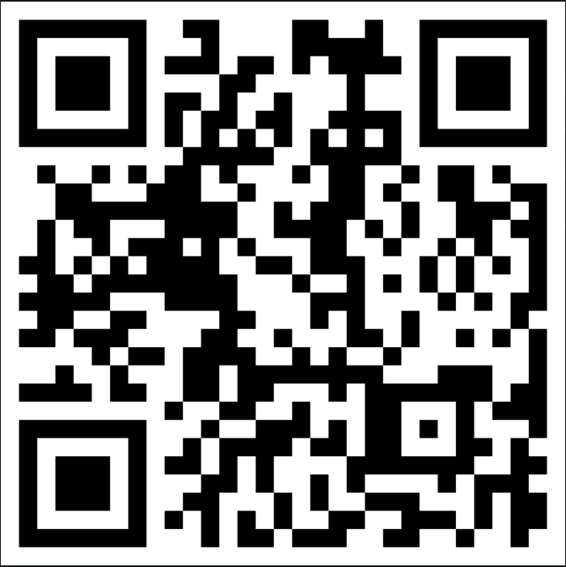
Attendance

Slide 3

Quick Announcement
Register by 2/7 to be eligible for a professional name badge.

Slide 4
The Contest
Go to open.kattis.com/contests and Ctrl+f “DSU”
Or go to this link: https://open.kattis.com/contests/urid5e
Range of problems, mostly pretty easy. Feel free to team up with others in the room and/or ask me questions if you are stuck!

